Slide 1
Unit 1
Introduction to Blokchain Technologies and its architecture

Slide 2
Introduction to Blockchain
A blockchain is a distributed database or ledger that is shared among the nodes of a computer network. As a database, a blockchain stores information electronically in digital format.
Blockchains are best known for their crucial role in cryptocurrency systems, such as Bitcoin, for maintaining a secure and decentralized record of transactions.
The innovation with a blockchain is that it guarantees the fidelity and security of a record of data and generates trust without the need for a trusted third party.

Slide 3
One key difference between a typical database and a blockchain is how the data is structured. A blockchain collects information together in groups, known as blocks that hold sets of information.
Blocks have certain storage capacities and, when filled, are closed and linked to the previously filled block, forming a chain of data known as the blockchain. All new information that follows that freshly added block is compiled into a newly formed block that will then also be added to the chain once filled.
A database usually structures its data into tables, whereas a blockchain, as its name implies, structures its data into chunks (blocks) that are strung together. This data structure inherently makes an irreversible timeline of data when implemented in a decentralized nature.
When a block is filled, it is set in stone and becomes a part of this timeline. Each block in the chain is given an exact timestamp when it is added to the chain.

Slide 4
What is Blockchain?
Blockchain is a type of shared database that differs from a typical database in the way that it stores information; blockchains store data in blocks that are then linked together via cryptography.
As new data comes in, it is entered into a fresh block. Once the block is filled with data, it is chained onto the previous block, which makes the data chained together in chronological order.
Different types of information can be stored on a blockchain, but the most common use so far has been as a ledger for transactions.

Slide 5
What is Blockchain?
In Bitcoin’s case, blockchain is used in a decentralized way so that no single person or group has control—rather, all users collectively retain control.
Decentralized blockchains are immutable, which means that the data entered is irreversible. For Bitcoin, this means that transactions are permanently recorded and viewable to anyone.

Slide 6
Definition of Blockchain:
Blockchain can be defined as a distributed ledger technology for storing information in such a manner that makes it tamper-proof.
It works on protocols designed to make an agreement among different parties who do not trust each other so that they can work together to achieve different purposes which benefit the whole group.
Blockchain technology first got its recognition when Satoshi Nakamoto published a research paper in 2008. The title of the research paper was ” A peer-to-peer electronic cash system”.

Slide 7
Why blockchain is important?
Business runs on information. The faster it’s received and the more accurate it is, the better.
Blockchain is ideal for delivering that information because it provides immediate, shared and completely transparent information stored on an immutable ledger that can be accessed only by permissioned network members.
A blockchain network can track orders, payments, accounts, production and much more. And because members share a single view of the truth, you can see all details of a transaction end to end, giving you greater confidence, as well as new efficiencies and opportunities.

Slide 8
Key elements of a blockchain:
Distributed ledger technology
All network participants have access to the distributed ledger and its immutable record of transactions. With this shared ledger, transactions are recorded only once, eliminating the duplication of effort that’s typical of traditional business networks.
Immutable records
No participant can change or tamper with a transaction after it’s been recorded to the shared ledger. If a transaction record includes an error, a new transaction must be added to reverse the error, and both transactions are then visible.
Smart contracts
To speed transactions, a set of rules — called a smart contract — is stored on the blockchain and executed automatically. A smart contract can define conditions for corporate bond transfers, include terms for travel insurance to be paid and much more.

Slide 9
Key elements of a blockchain:
Distributed ledger technology
All network participants have access to the distributed ledger and its immutable record of transactions. With this shared ledger, transactions are recorded only once, eliminating the duplication of effort that’s typical of traditional business networks.
Immutable records
No participant can change or tamper with a transaction after it’s been recorded to the shared ledger. If a transaction record includes an error, a new transaction must be added to reverse the error, and both transactions are then visible.
Smart contracts
To speed transactions, a set of rules — called a smart contract — is stored on the blockchain and executed automatically. A smart contract can define conditions for corporate bond transfers, include terms for travel insurance to be paid and much more.

Slide 10
Advantages of Blockchain Technology:
1. Open: One of the major advantages of blockchain technology is that it is accessible to all means anyone can become a participant in the contribution to blockchain technology, one does not require any permission from anybody to join the distributed network.
2. Verifiable: Blockchain technology is used to store information in a decentralized manner so everyone can verify the correctness of the information by using zero-knowledge proof through which one party proves the correctness of data to another party without revealing anything about data.
3. Permanent: Records or information which is stored using blockchain technology is permanent means one needs not worry about losing the data because duplicate copies are stored at each local node as it is a decentralized network that has a number of trustworthy nodes.

Slide 11
4. Free from Censorship: Blockchain technology is considered free from censorship as it does not have control of any single party rather it has the concept of trustworthy nodes for validation and consensus protocols that approve transactions by using smart contracts.
5. Tighter Security: Blockchain uses hashing techniques to store each transaction on a block that is connected to each other so it has tighter security. It uses SHA 256 hashing technique for storing transactions.
6. Immutability: Data cannot be tampered with in blockchain technology due to its decentralized structure so any change will be reflected in all the nodes so one cannot do fraud here, hence it can be claimed that transactions are tamper-proof.

Slide 12
7. Transparency: It makes histories of transactions transparent everywhere all the nodes in the network have a copy of the transaction in the network. If any changes occur in the transaction it is visible to the other nodes.
8. Efficiency: Blockchain removes any third-party intervention between transactions and removes the mistake making the system efficient and faster. Settlement is made easier and smooth.
9. Cost Reduction: As blockchain needs no third man it reduces the cost for the businesses and gives trust to the other partner.

Slide 13
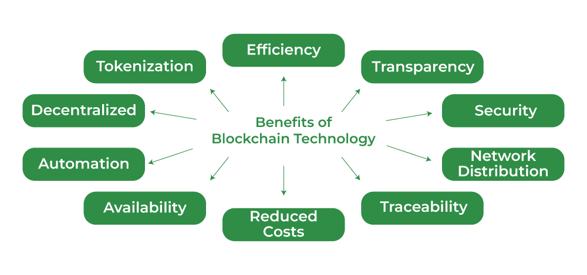
Advantages of Blockchain Technology

Slide 14
Disadvantages of Blockchain Technology:
1. Scalability: It is one of the biggest drawbacks of blockchain technology as it cannot be scaled due to the fixed size of the block for storing information. The block size is 1 MB due to which it can hold only a couple of transactions on a single block.
2. Immaturity: Blockchain is only a couple-year-old technology so people do not have much confidence in it, they are not ready to invest in it yet several applications of blockchain are doing great in different industries but still it needs to win the confidence of even more people to be recognized for its complete utilization.
3. Energy Consuming: For verifying any transaction a lot of energy is used so it becomes a problem according to the survey it is considered that 0.3 percent of the world’s electricity had been used by 2018 in the verification of transactions done using blockchain technology.

Slide 15
4. Time-Consuming: To add the next block in the chain miners need to compute nonce values many times so this is a time-consuming process and needs to be speed up to be used for industrial purposes.
5. Legal Formalities: In some countries, the use of blockchain technology applications is banned like cryptocurrency due to some environmental issues they are not promoting to use blockchain technology in the commercial sector.
6. Storage: Blockchain databases are stored on all the nodes of the network creates an issue with the storage, increasing number of transactions will require more storage.
7. Regulations: Blockchain faces challenges with some financial institution. Other aspects of technology will be required in order to adopt blockchain in wider aspect.

Slide 16
Types of Software Architecture
There are many ways to implement software systems. However, one of the fundamental decisions when implementing a system concerns its architecture, the way in which its components are organized and related to one another.
The two major architectural approaches for software systems are centralized and distributed.
In centralized software systems, the components are located around and connected with one central component. In contrast, the components of distributed systems form a network of connected components without having any central
element of coordination or control.

Slide 17
Figure 2-1 depicts these two contrary architectures. The circles in the figure represent system components, also called nodes, and the lines represent connections between them. At this point, it is not important to know the details of what these components do and what information is exchanged between the nodes.
The important point is the existence of these two different ways
of organizing software systems. On the left-hand side of Figure 2-1, a distributed architecture is illustrated where components are connected with one another without having a central element.
It is important to see that none of the components is directly connected with all other components. However, all components are connected with one another at least indirectly.

Slide 18
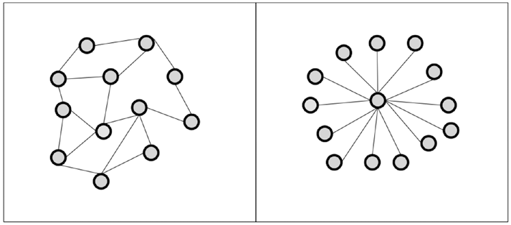
The right-hand side of Figure 2-1 illustrates a centralized architecture where each component is connected to one central component. The components are not connected with one another directly. They only have one direct connection to the central component.
Figure 2-1. Distributed (left) vs. centralized (right) system architecture

Slide 19
The Advantages of Distributed Systems
The major advantages of a distributed system over single computers are:
• Higher computing power
• Cost reduction
• Higher reliability
• Ability to grow naturally
The Disadvantages of Distributed Systems
The disadvantages of distributed systems compared to single computers are:
• Coordination overhead
• Communication overhead
• Dependency on networks
• Higher program complexity
• Security issues

Slide 20
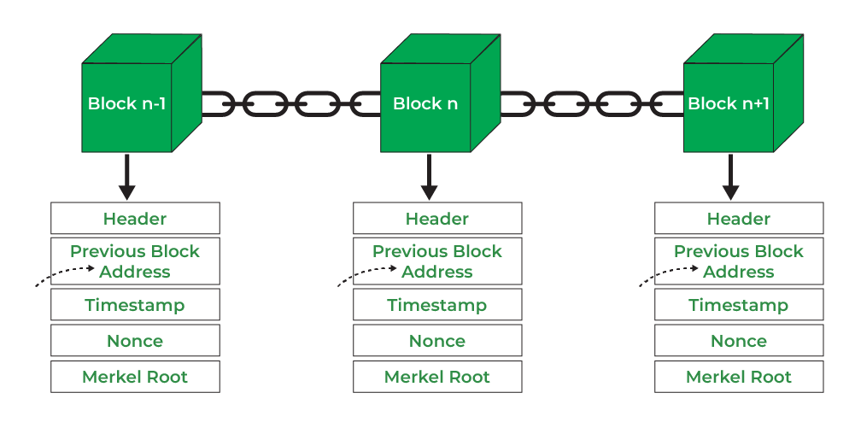
Blockchain Architecture
Blockchain is a technology where multiple parties involved in communication can perform different transactions without third-party intervention. Verification and validation of these transactions are carried out by special kinds of nodes.
Blockchain Architecture

Slide 21
Header: It is used to identify the particular block in the entire blockchain. It handles all blocks in the blockchain. A block header is hashed periodically by miners by changing the nonce value as part of normal mining activity, also Three sets of block metadata are contained in the block header.
Previous Block Address/ Hash: It is used to connect the i+1th block to the i^{th} block using the hash. In short, it is a reference to the hash of the previous (parent) block in the chain.
Timestamp: It is a system verify the data into the block and assigns a time or date of creation for digital documents. The timestamp is a string of characters that uniquely identifies the document or event and indicates when it was created.

Slide 22
Nonce: A nonce number which uses only once. It is a central part of the proof of work in the block. It is compared to the live target if it is smaller or equal to the current target. People who mine, test, and eliminate many Nonce per second until they find that Valuable Nonce is valid.
Merkel Root: It is a type of data structure frame of different blocks of data. A merkel tree stores all the transactions in a block by producing a digital fingerprint of the entire transaction. It allows the users to verify whether a transaction can be included in a block or not.

Slide 23
Types of Blockchain Architecture
1. Public Blockchain:
A public blockchain is a concept where anyone is free to join and take part in the core activities of the blockchain network. Anyone can read, write, and audit the ongoing activities on a public blockchain network, which helps to achieve the self-determining, decentralized nature often authorized when blockchain is discussed.
Data on a public blockchain is secure as it is not possible to modify once they are validated.
The public blockchain is fully decentralized, it has access and control over the ledger, and its data is not restricted to persons, is always available and the central authority manages all the blocks in the chain.

Slide 24
There is publicly running all operations. Due to no one handling it singly then there is no need to get permission to access the public blockchain.
Anyone can set his/her own node or block in the network.
After a node or a block settled in the chain of the blocks, all the blocks are connected like peer-to-peer connections. If someone tries to attack the block then it forms a copy of that data and it is accessible only by the original author of the block.

Slide 25
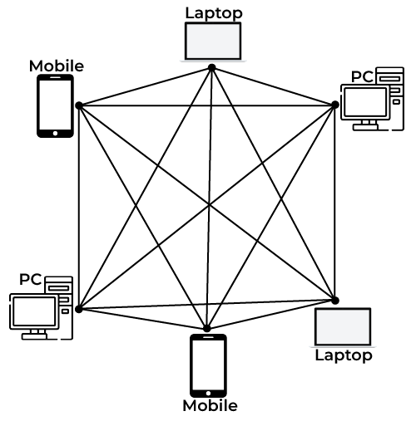
Public blockchain

Slide 26
Advantages:
A public network operates on an actuate scheme that encourages new persons to join and keep the network better.
There is no agreement in the public blockchain.
This means that a public blockchain network is immutable.
It has Rapid transactions.
Disadvantages:
Public blockchain can be costly in some manner.
The person need not give identity, that’s why there is a possibility of corruption of the block if it is in under attack.
Processing speed is sometimes slow.
It has Integration issues.

Slide 27
2. Private Blockchain
Miners need permission to access a private blockchain. It works based on permissions and controls, which give limit participation in the network.
Only the entities participating in a transaction will have knowledge about it and the other stakeholders not able to access it.
By it works on the basis of permissions due to this it is also called a permission-based blockchain. Private blockchains are not like public blockchains it is managed by the entity that owns the network.
A trusted person is in charge of the running of the blockchain it will control who can access the private blockchain and also controls the access rights of the private chain network.
There may be a possibility of some restrictions while accessing the network of the private blockchain.

Slide 28
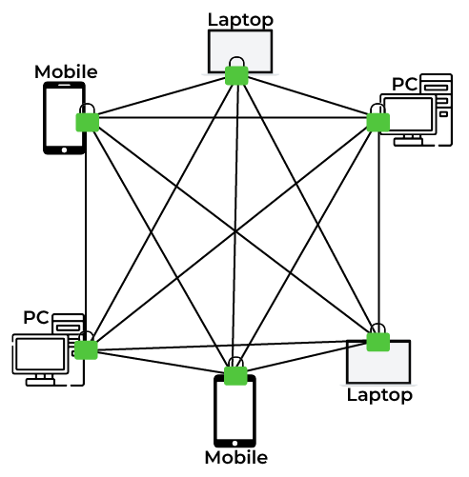
Private Blockchain

Slide 29
Advantages:
In a private blockchain, users join the network using the invitations and all are verified.
Only permitted users/ persons can join the network.
Private Blockchain is partially immutable.
Disadvantages:
A private blockchain has trust issues, due to exclusive information being difficult to access it.
As the number of participants increases, there is a possibility of an attack on the registered users.

Slide 30
3. Consortium Blockchain
A consortium blockchain is a concept where it is permissioned by the government and a group of organizations, not by one person like a private blockchain. Consortium blockchains are more decentralized than private blockchains, due to being more decentralized it increases the privacy and security of the blocks.
Those like private blockchains connected with government organizations’ blocks network.
Consortium blockchains is lies between public and private blockchains. They are designed by organizations and no one person outside of the organizations can gain access. In Consortium blockchains all companies in between organizations collaborate equally.
They do not give access from outside of the organizations/ consortium network.

Slide 31
Advantages:
Consortium blockchain providers will always try to give the fastest output as compared to public blockchains.
It is scalable.
A consortium blockchain is low transaction costs.
Disadvantages:
A consortium blockchain is unstable in relationships.
Consortium blockchain lacks an economic model.
It has flexibility issues.

Slide 32
Core Components of Blockchain Architecture
Node: Nodes are network participants and their devices permit them to keep track of the distributed ledger and serve as communication hubs in various network tasks. A block broadcasts all the network nodes when a miner looks to add a new block in transactions to the blockchain.
Transactions: A transaction refers to a contract or agreement and transfers of assets between parties. The asset is typically cash or property. The network of computers in blockchain stores the transactional data as copy with the storage typically referred to as a digital ledger.
Block: A block in a blockchain network is similar to a link in a chain. In the field of cryptocurrency, blocks are like records that store transactions like a record book, and those are encrypted into a hash tree.

Slide 33
Chain: Chain is the concept where all the blocks are connected with the help of a chain in the whole blockchain structure in the world. And those blocks are connected with the help of the previous block hash and it indicates a chaining structure.
Miners: Blockchain mining is a process that validates every step in the transactions while operating all cryptocurrencies. People involved in this mining they called miners. Blockchain mining is a process to validate each step in the transactions while operating cryptocurrencies.
Consensus: A consensus is a fault-tolerant mechanism that is used in computer and blockchain systems to achieve the necessary agreement on a single state of the network among distributed processes or multi-agent systems, such as with cryptocurrencies. It is useful in record keeping and other things.

Slide 34
Blockchain Architecture Vs Database
Below are some of the differences between blockchain architecture and database:
Parameters | Blockchain Architecture | Database
Control | Blockchain is decentralized because there is no single point of failure and there is no central authority to control the blockchain. | The database is Centralized.
Operations | Blockchain has only an Insert operation. | The database has Create, Read, Update, and Delete operations.
Strength | It is robust technology. | The database is not fully robust technology.
Mutability | Blockchain is immutable technology and we cannot change it back or we cannot go back. | The database is a fully mutable technology, The data can be edited in the database.
Rights | Anyone with the right proof of work can write on the blockchain. | In the database reading and writing can do so.
Speed | It is slow in speed. | It is faster as compared to blockchain.

Slide 35
Applications of Blockchain are as follows:
1. Bitcoin: The primary application of Blockchain is in Cryptocurrencies like Bitcoin. Bitcoin is a decentralized digital currency introduced by Santoshi Nakamoto.
2. Banking: Nowadays, Blockchain is also replacing the existing, or we can say overtaking the current Banking system. With the help of Blockchain, we can transfer the fund from one person to another in a second because the transaction’s validation will take place through Blockchain and cryptography. It’s a possibility that Blockchain will cut down 19.8 Billion Dollars which is going for middleman cost/year. Because of the Blockchain, the hacking of accounts will become impossible.
3. Payment and Transfers: Because of Blockchain, only the wallet system has grown up so rapidly, and by using that, we can make the payment and money transfers very quickly; we don’t need to enter the public key. We need to scan a unique QR code and pay soon. The amount done by Blockchain will be highly secure with no transfer fees. For blockchain transfer, no bank account is needed.

Slide 36
4. Healthcare: Healthcare is also a domain where Blockchain technology has been used for storing the details of the patients. This technology ensures that anyone accessing this Blockchain can access patients’ data. This database will be highly secure and for checking the data related to the patient-doctor has to log in there with the public key and details, and he can check the patients’ data.
5. Law Enforcement: The law enforcement agency is also now applying applications of Blockchain technology. So that they can create a Common Database of the criminal and the crimes committed by them with all the biometric details. Since it’s highly secure, nobody can change it without proper access.
6. Voting: Blockchain can be used in the next election or Voting because of its unchanging revolutionary nature. Voting will become more secure and fail-proof with the help of Blockchain.

Slide 37
7. IoT(Internet of Things): Blockchain is also now used by IoT. This ensures that data that will transfer over or between the devices will be secure and encrypted without any interference.
8. Online music: Online music is one field that is increasing with the help of Blockchain technology. Companies are putting their music in a blockchain where everyone can access the music, but none can change it, and a customer can pay for a particular song and then he can download it from the Blockchain itself.
9. Real estate: Real estate is also a domain that is affected by the applications of Blockchain, and in the future, people will sell and buy property over the Blockchain.
10. Digital IDs: Blockchain is also now used by different companies for Digital Id. These digital IDs will be managed by the owner’s private keys and will also help avoid excess personal information over the internet.

Slide 38
Design Principles of Blockchain:
1) Design for trust: Many of our users are in industries that deal with highly sensitive information and maintaining their trust is critical to our business. Almost everyone is “new” to blockchain, with varying levels of understanding and confidence. Users must perceive our products (and the people behind them) to be reliable, trustworthy, and stable.
2) Data exposure: Some users require more exposure to blockchain data than others—many will need to see how the blockchain technology is replacing their previous processes to feel that it is trustworthy. The exposure of data affects users’ understanding of how the application works.
3) Consistency: Having a consistent user experience allows our users to feel at ease, it is particularly important with new blockchain technology as this enables adoption and learning.

Slide 39
4) Constant feedback: Help users understand what is happening and reduce anxiety by designing constant feedback. Motion and animation supports understanding of what is happening. The user should always know what is happening, what just happened, and what will happen next.
5) Allow for and anticipate mistakes to be made: Because a blockchain is effectively immutable, pay extra attention to user actions that are irreversible. Add in levels of friction or confirmation to reduce error and direct to next steps, should a mistake occur.
6) Active Guidance: Zero states are common in many of products, so make sure to provide a natural next step. Users must have clear, persistent navigation — they should easily know how to get back to a previous state and what their next step is.
Anticipates the need for further help and seeks to reduce it, while being cognizant of where our personas are most likely to go for help. Create transparency and eliminate uncertainty, and give suggestions for the things users don’t remember.

Slide 40
The Blockchain Ecosystem:
All over the world, people have continuously struggled with keeping their personal and business finances safe. However, the success rate for financial security goes up a few notches with blockchain technology.
Blockchain is a decentralized ledger that creates an open and shared database of transactions or records which cannot be altered retroactively or distributed across multiple networks without the broad consensus of participants in these networks.
The blockchain ecosystem is the network of all the participants in the blockchain network that share the business process and business objectives.
The ecosystem encompasses the different governing structures like:
Individual participation.
Data ownership.
Exit and entrance criteria.
Information and data shared with the system’s participants.

Slide 41
It can provide immutability, decentralization, flexibility for day-to-day operations, and scalability. The blockchain ecosystem is a boon for startups and new technology projects as it creates an interconnected network.
Types of Blockchain Ecosystem:
Below are the three different types of blockchain ecosystems:
Single-party led blockchain ecosystem: This ecosystem is led by a single organization where all the stakeholders have a mutual benefit for participating in the network. For example, Bumble Bee Foods has created a single-party-led blockchain ecosystem to improve the traceability of the yellowfin tuna fish. This helped to improve the buyer’s confidence in the fish’s freshness.
Regulatory blockchain ecosystem: This ecosystem comprises various government agencies that hare a project and have to self-report for compliance. For example, a shared project between Marine Transport International and Recycling Association.

Slide 42
Joint venture blockchain ecosystem: This is also known as the Consortium blockchain ecosystem. These are slowly becoming popular and they involve two or more organizations in the ecosystem. The participating organizations have an objective of participating in a common activity or pooling their resources for achieving a common goal. For example, BunkerTrace a marine fuel tracking solution is a joint venture blockchain ecosystem between Forecast technology Ltd. and Blockchain Labs for Open Collaboration (BLOC).

Slide 43
Important of Blockchain ecosystems for Organizations
Below are some of the reasons why an ecosystem is an essential solution for organizations:
Integration across enterprise boundaries: Blockchain ecosystems enable integration across the enterprise boundaries allowing organizations to deliver products or services that they won’t be able to deliver on their own due to the lack of technological capabilities.
Allow organizations to overcome traditional mindset: The blockchain ecosystem helps organizations to move beyond their traditional mindset as well as the dynamic limitations of a particular supply-chain network.

Slide 44
How can the blockchain Ecosystem Benefit Organizations?
Blockchain technology is having a profound effect on every aspect of our lives and economy, starting with disrupting business processes.
One of the advantages of blockchains, as opposed to traditional databases, is that blockchains are decentralized and transparent, greatly reducing risks while providing complete security.
Below are some of the ways in which the blockchain ecosystem can benefit organizations:
Distributed, Improve ongoing operation, Consensus, Smart contracts, Transparency, Remodel complete workflow, Facilitate cross-enterprise collaboration

Slide 45
Participants in Blockchain Ecosystem
Below are the five participants in the blockchain ecosystem:
Leaders: Leaders take control of everything happening on the blockchain network. They are the organizations that have a vision of the future of the blockchain ecosystem and its business values. These are the creators of the project and are the main beneficiaries of the work in the ecosystem.
Core group: The core group refers to the group of active or leading organizations in the network that gives shape to operational activities in the network. They are responsible for controlling, streamlining, and managing the blockchain ecosystem actively.
Active participants: These are the group of primary network participants that take on the responsibility of contributing to workflow, governance, and data management.

Slide 46
Users: They don’t get any responsibility for the active management of the network. Their only responsibility in the ecosystem is to obtain desired benefits from the network alongside accessing their own data.
Third-party service providers: They are important participants in the network and offer different types of services on the network. They could offer desired services like IT support services or infrastructure and applications services in exchange for specific fees.

Slide 47
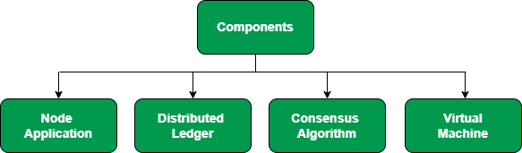
Components of Blockchain Ecosystem
The important logical components in the blockchain ecosystem are as follows:

Slide 48
Steps in Forming Blockchain Ecosystem
Steps in building and scaling the blockchain ecosystem are:
1. Ecosystem value proposition: This step includes defining the fundamental purpose of the ecosystem actions. Like, How would the blockchain ecosystem impact each of the participants?
2. Expected participants: This step involves brainstorming for the expected participants to determine why they want to join the blockchain ecosystem.
3. Ecosystem model: Organization will decide to have an idea on which collaboration model will be the best fit for their purpose.
4. Ecosystem governance: This is the most important step as it is very important to consider who will operate the network and how it will be governed.
5. Organizations’ preparation: Each organization must have an idea about what benefits it can derive from joining the ecosystem.

